Slide 1


Automate workload migration using TerraForm
M.Nehad
DevSecOps/Cloud Native Architect

Slide 2


Agenda
Cloud Migration using IaaC
What’s TerraForm
TerraForm Commands
Demo 1
Install TerraForm
Configure AWS CLI
Simple example
Demo 2
Migrate App servers
Demo 3
Migrate K8s Cluster (EKS)

Slide 3
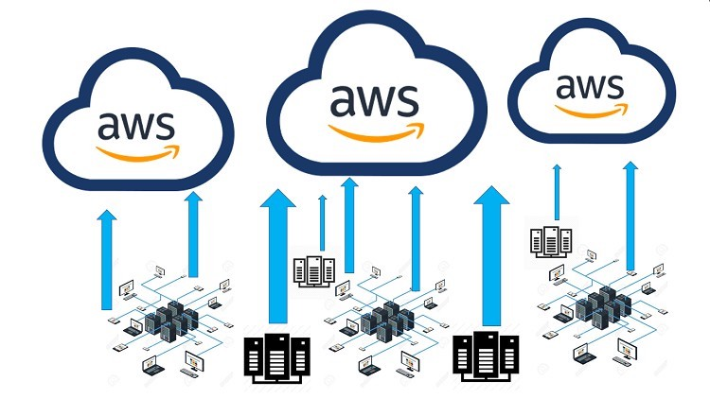
Cloud Migration

Slide 4
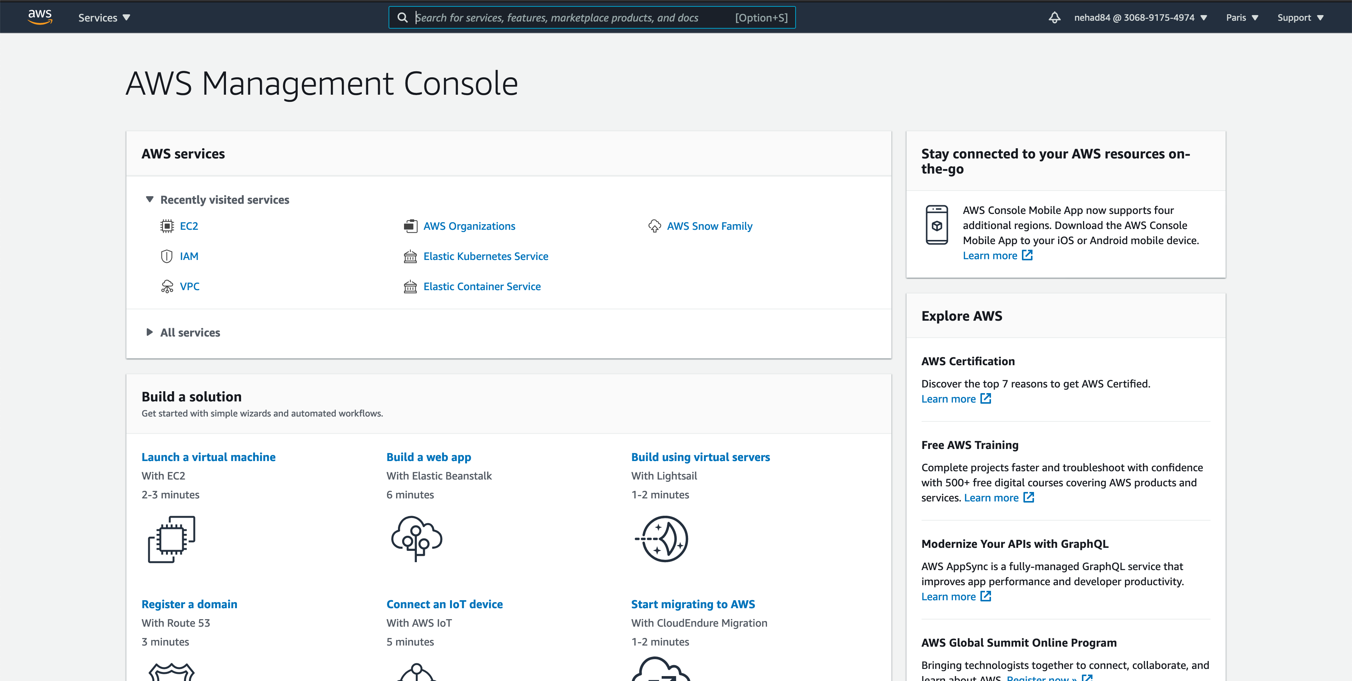
Desgin using AWS Console

Slide 5

Now repeat!!
That was just one account. Can you do the same in rest of the 99 accounts?

Slide 6
Wrong region!!
You did it in the wrong region. Can you fix that?

Slide 7
Write Once deploy multiple

Slide 8
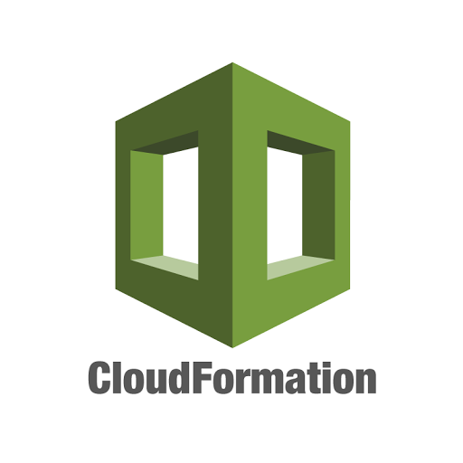

IaaC most common used tools

Slide 9
Benefits of Iaac
Visibility
Scalability
Stability
Security
Transactional

Slide 10
What’s ?
HashiCorp product
An open-source provisioning declarative tool that based on Infrastructure as a Code paradigm
Written in Golang and uses own syntax – HCL (Hashicorp Configuration Language), but also supports JSON
Terraform is not a cloud agnostic tool. It embraces all major Cloud Providers and provides common language to orchestrate the infrastructure resources

Slide 11
Commands
Init
initializes a working directory containing Terraform configuration files.
performs
backend initialization , storage for terraform state file.
modules installation, downloaded from terraform registry to local path
provider(s) plugins installation, the plugins are downloaded in the sub-directory of the present working directory at the path of .terraform/plugins
supports -upgrade to update all previously installed plugins to the newest version that complies with the configuration’s version constraints

Slide 12
Commands
Plan
create a execution plan
calculates the difference between the last-known state and the current state and presents this difference as the output of the terraform plan operation to user in their terminal
does not modify the infrastructure or state.
allows a user to see which actions Terraform will perform prior to making any changes to reach the desired state
scan all *.tf files in the directory and create the plan

Slide 13
Commands
Apply
apply changes to reach the desired state, modify the infrastructure and the state
scans the current directory for the configuration and applies the changes appropriately.
if a resource successfully creates but fails during provisioning,
Terraform will error and mark the resource as “tainted”.
A resource that is tainted has been physically created, but can’t be considered safe to use since provisioning failed.
Terraform also does not automatically roll back and destroy the resource during the apply when the failure happens,
supports -auto-approve to apply the changes without asking for a confirmation

Slide 14
Commands
Destroy
destroy the infrastructure and all resources
modifies both state and infrastructure
terraform destroy -target can be used to destroy targeted resources
terraform plan -destroy allows creation of destroy plan

Slide 15
Commands
Validate : validates syntactically for format and correctness
Refresh: used to reconcile the state Terraform knows about (via its state file) with the real-world infrastructure, does not modify infrastructure, but does modify the state file
Import: helps import already-existing external resources, not managed by Terraform, into Terraform state and allow it to manage those resources, Terraform is not able to auto-generate configurations for those imported modules
Taint: marks a Terraform-managed resource as tainted, forcing it to be destroyed and recreated on the next apply
Fmt: format to lint the code into a standard format

Slide 16
Demo 1

Slide 17
Demo 2

Slide 18
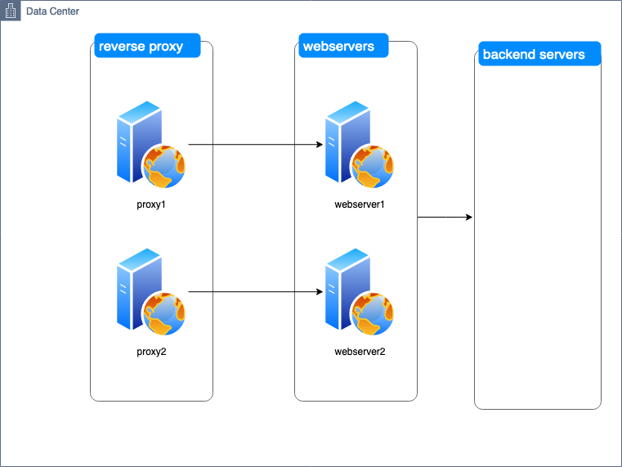
Demo 2

Slide 19
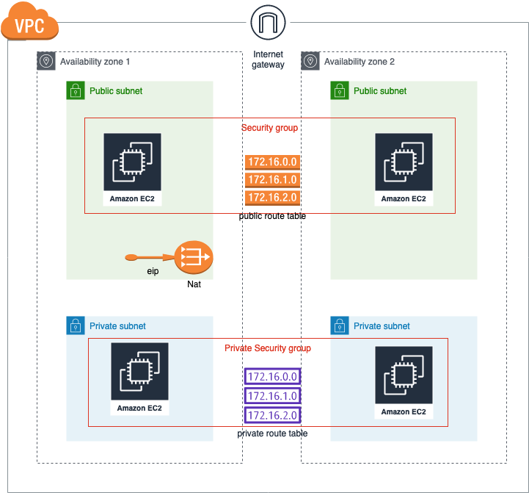
Demo 2

Slide 20
Demo 3

Slide 21
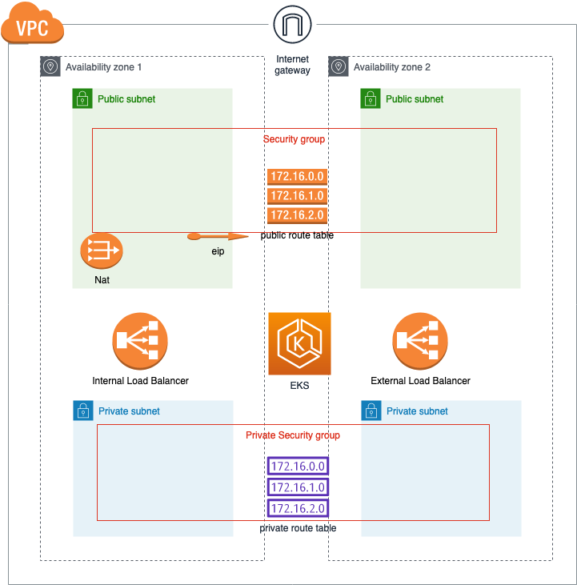
Demo 3

